Slide 1
Virtual Assistant Design and implementation Using fine-tuned BERT
Sunil Mandhan, June 2020

Slide 2

1. Background
MR is also a complex modality with numerous parameters and planning challenges. To add to this it is an evolving modality with new applications and techniques introduced on a regular basis. MR operators require lots of training and hand-holding to use the new applications efficiently.
Virtual assistant always available for the operator to help him in all his day to day tasks
Handling complexity
Focus on Diagnosis
Patient Experience
Mebef formula
Scan parameter
Scan failure event
List of etl5 tables
Acceleration factor
Instead of starting big for MR, lets start for a analytics tool used across MR. Similar analytics tools should be used by CT, IGT, etc.

Slide 3
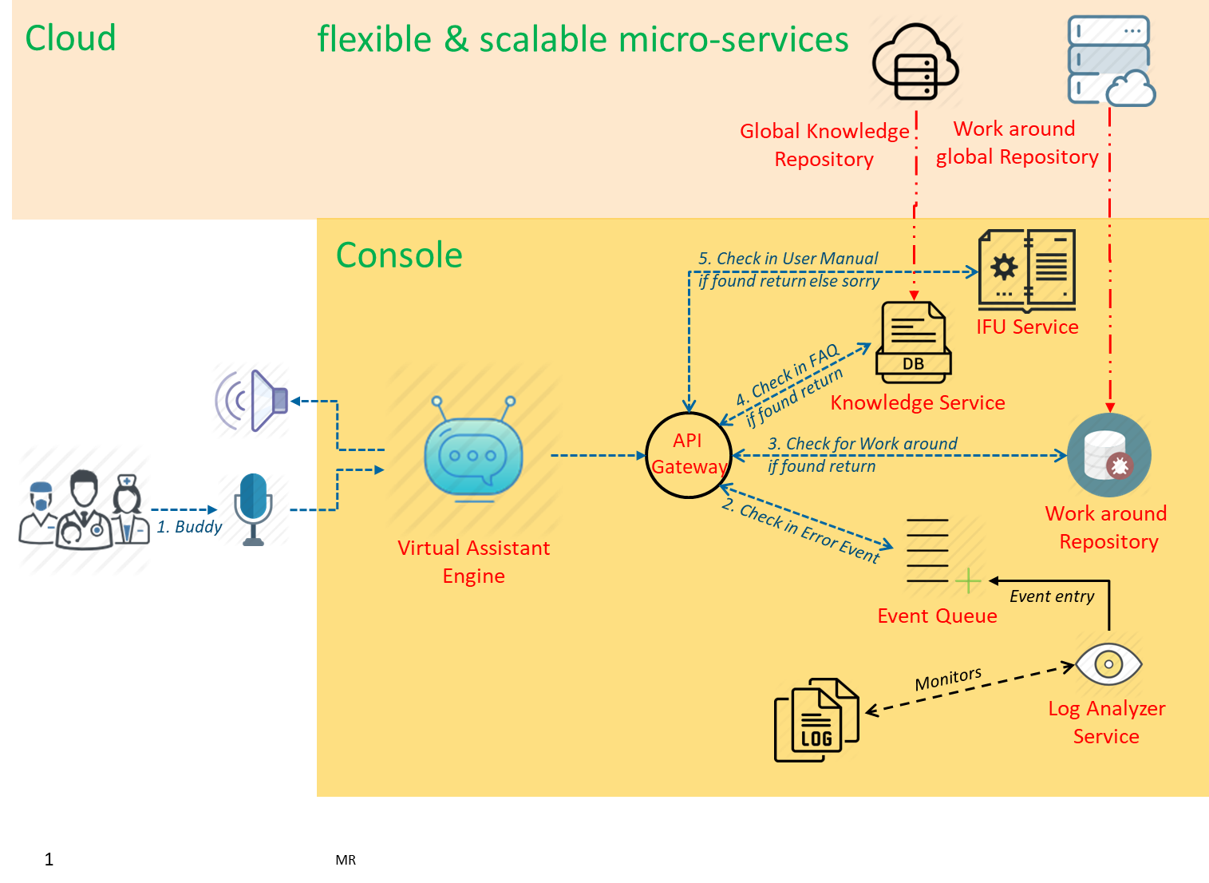
2. The proposed solution

Slide 4
3. Approach
Not in scope
First iteration

Slide 5
4. High Level Design – fetching knowledge
Use of BERT to encode
Use of BERT to encode

Slide 6
5. High Level Design – Data adaptors
Start with the config file and then
automatically identify the sections later
Use of BERT to encode

Slide 7
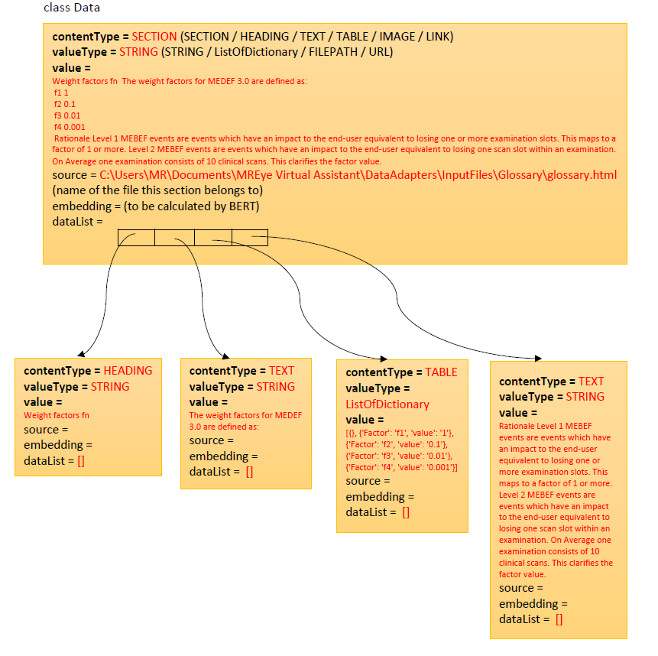
6. Low level Design

Slide 8
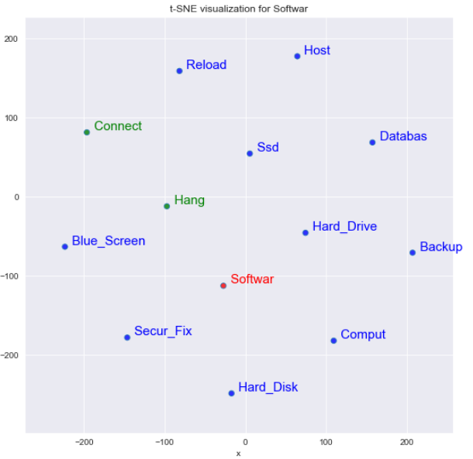
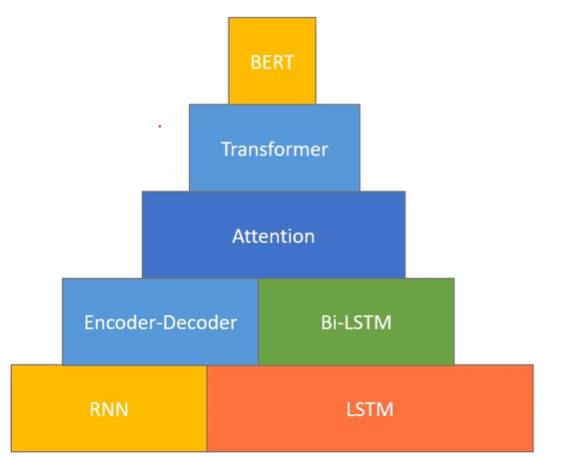
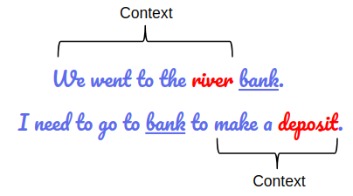
7. How it works – technology behind
We selected BERT based on our literature survey and ease of use
Plenty of working examples and fine tuning details
experience of using word2vec embeddings for customer complaints
Prebuilt BERT models give a vector from words composition
not from the intent of the sentence as a whole
We fine tuned the BERT model on text similarity
using triplets of – anchor, contradiction, entailment
Specific problems
(like semantic search)
One embedding for a word
Prebuilt BERT
Finetuned BERT
multiple embeddings for a word

Slide 9
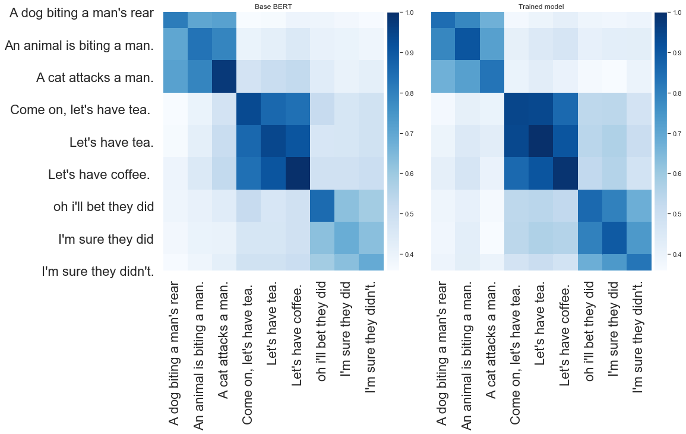
8. Problem with Base BERT - 1

Slide 10
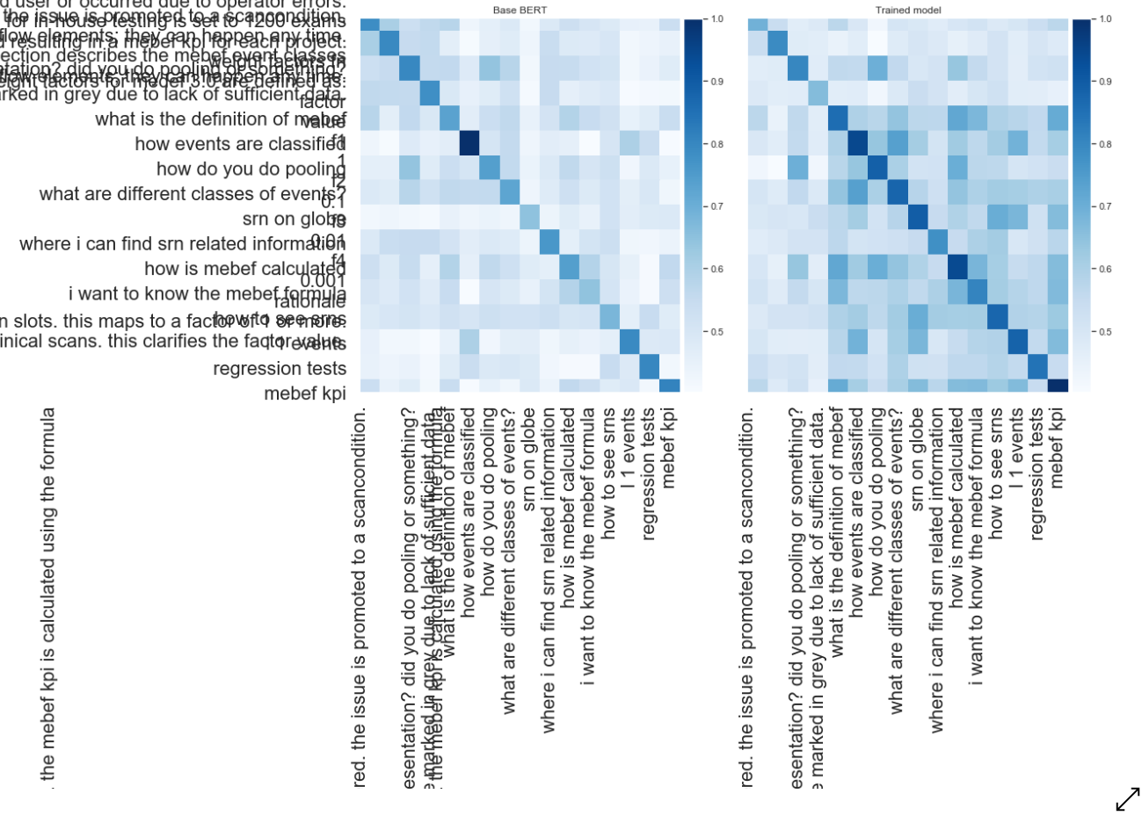
9. Problem with Base BERT - 2

Slide 11
10. Closing remarks
Testing
We created some test cases for our query and measured the results returned by VA against prenoted answers. We fixed the target around > 80%
Out of vocabulary words
Breaks the word into multiple words (already in vocab)
Enrichment of vocabulary
You can add your domain words in empty slots in vocab
or retrain BERT from scratch
Learn more - http://jalammar.github.io/illustrated-bert/

